Slide 1


STATISTICAL REVIEW OF FACTORS THAT IMPACT NBA SCORED POINTS
Bortiorkor Nii Tsui Alabi
Anirudh Giridhar
Won Hyun Kim
Andrew Lang
Ernest Lee
Andrew Lim

Slide 2

Part 1: Introduction (Background)
Basketball is a popular sport around the world
Coaches always look for tactical ways to win games and maximize team performance
We would like to run a regression analysis on chosen dataset to explore strategies to winning more points
NBA ensures the competitiveness of the sports to increase revenue and franchise patronage
Factors of Interests: 1) Percentage of 3 Point Shots, 2) Percentage of Field Goals, 3) Assists, 4) Rebounds, 5) Turnovers, 6) Total Fouls, 7) Steals
Several attempts have been made to study similar data such as:
Mikołajec, K., Maszczyk, A., & Zając, T. (2013). Game Indicators Determining Sports Performance in the NBA. Journal of human kinetics, 37, 145–151.
Hojka, V., Stastny, P., Rehak, T., Gołas, A., Mostowik, A., Zawart, M., & Musálek, M. (2016). A systematic review of the main factors that determine agility in sport using structural equation modeling. Journal of human kinetics, 52, 115–123. https://doi.org/10.1515/hukin-2015-0199
Notes:
Basketball is a prominent sport in the world today with national professional sports leagues, and recognition as an Olympic sport. The National Basketball Association as a corporation in the united states has fostered several tactical and strategic measures to improve revenues, promote the NBA franchises, and encourage overall favorable national appeal.
NBA club owners and coaches over the years have incorporated quantitative and scientific measures to exploring efficiency to gaming opportunities and factors of player performance improvement. Also, analytical interpretations of key game outputs such as scorings and free throws provide bases for calculations of key metrices like the player efficiency ratings which is needed for coaches to develop winning strategies.
And in the game of Basketball as team win by scoring more points; in this research, we investigate key scoring factors of, Percentage of 3 Point Shots, Percentage of Field Goals, Assists, Rebounds, Turnovers, Total Fouls, and Steals that significantly impact the amount of points obtained by NBA teams.
Our research team found theoretical concepts from similar literature by Mikotajec et. al., who in 2013 used regression modeling to identify basketball game performance indicators which best determine sports level in the NBA league.
Consequently, we also choose to explore our selected dataset for strategies of winning more points by running regression analysis.
References to Similar research
1. https://doi.org/10.2478/hukin-2013-0035
2. Hojka, V., Stastny, P., Rehak, T., Gołas, A., Mostowik, A., Zawart, M., & Musálek, M. (2016). A systematic review of the main factors that determine agility in sport using structural equation modeling. Journal of human kinetics, 52, 115–123. https://doi.org/10.1515/hukin-2015-0199

Slide 3

Data Source
We analyzed data from Kaggle.com in order to answer the research question.
Please click on the link below To access the data:
https://www.kaggle.com/ionaskel/nba-games-stats-from-2014-to-2018
Navigate to nba.games.stats.csv on this page and click the “download” button.
Reference article used:
Mikołajec, K., Maszczyk, A., & Zając, T. (2013). Game Indicators Determining Sports Performance in the NBA. Journal of human kinetics, 37, 145–151.
Notes:
We sourced the data, nba.games.stats.csv, from Kaggle.com, for our statistical analysis in answering our research questions.
One can access the data by browsing for Kaggle.com and navigating to the nba.games.csv file.
Please see the data URL link as displayed on the slide

Slide 4

Research Question
Which factors have the largest influence on the amount of points scored?
To answer these we examine data for the Indianapolis Pacers over hundred games and applied a regression analysis
Is there significant relationship(s) between/among the selected factors?
How does a unit surge or decline in any of the factors impact amount of points scored?
Notes:
We would like to know which factors are most important for scoring more team points.
To do this we examine data for the Indianapolis Pacers over a few hundred games and apply a regression analysis.

Slide 5
Dataset characteristic
Variable | Description | Range | Variable Type
X3PointShots | Percentage of 3-point shots made | (0, 0.75) | Continuous
FieldGoals | Percentage of field goals made | (19, 58) | Continuous
Assists | Number of assists | (6, 47) | Discrete
Rebounds | Number of rebounds | (19, 58) | Discrete
Turnovers | Number of turnovers | (2, 29) | Discrete
TotalFouls | Number of fouls | (7, 42) | Discrete
Steals | Number of steals | (0, 21) | Discrete
TeamPoints | Total number of points scored | (64, 149) | Discrete
Notes:
A table showing the response variable and the explanatory variables in different colors. Describe the definition, unit, type and range.

Slide 6
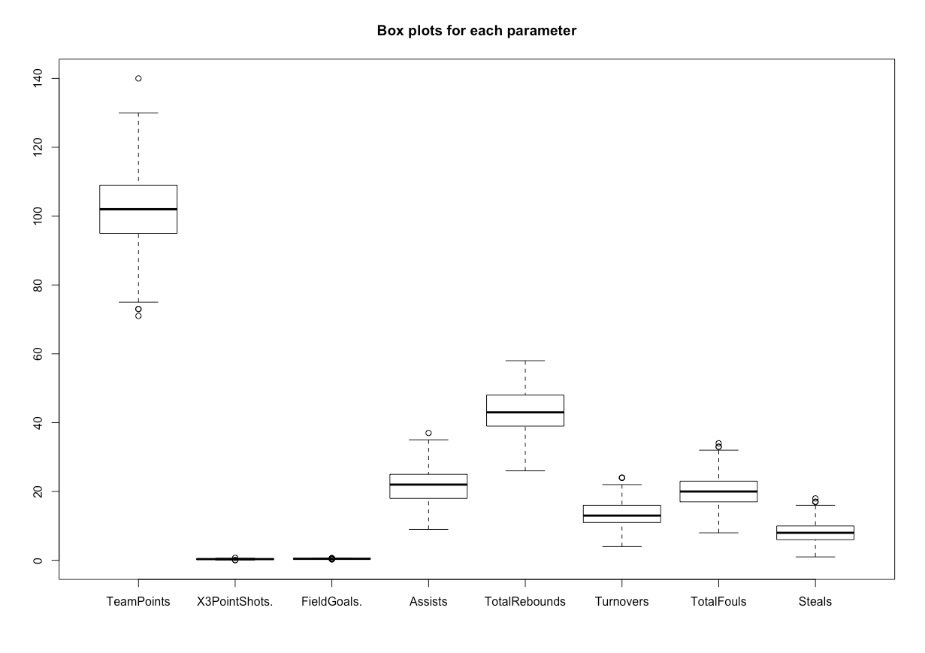
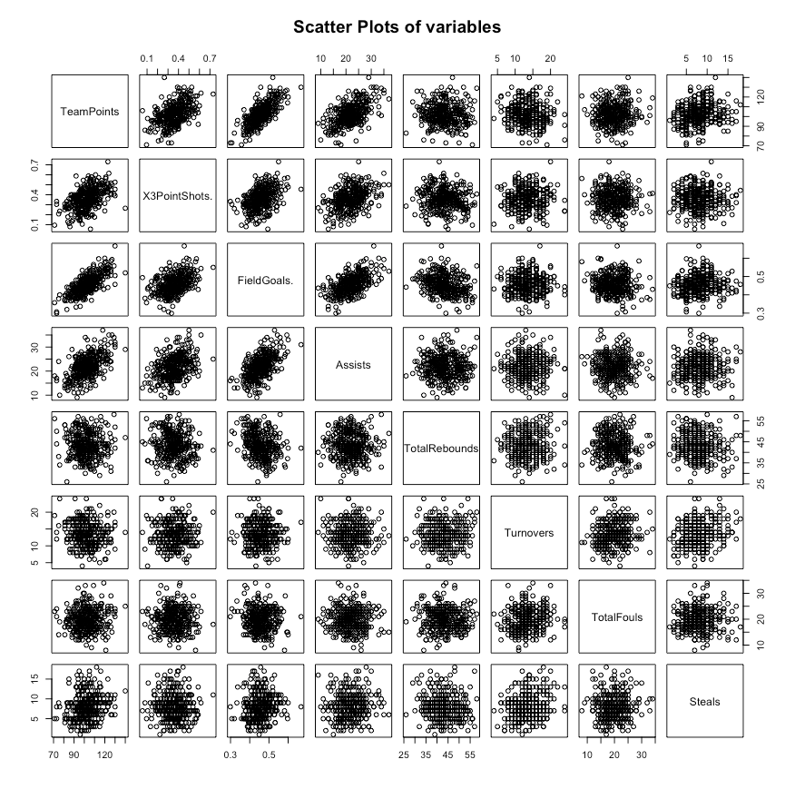
Part 3: Preliminary analysis: Boxplots, Scatterplots and Histograms

Slide 7
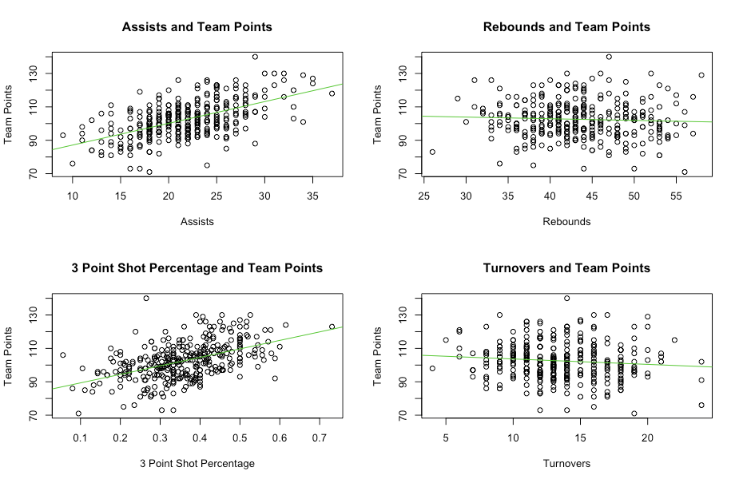
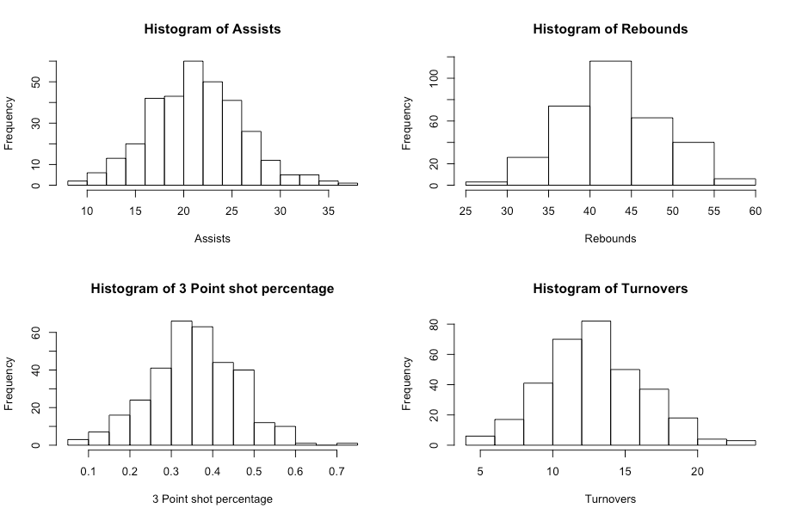
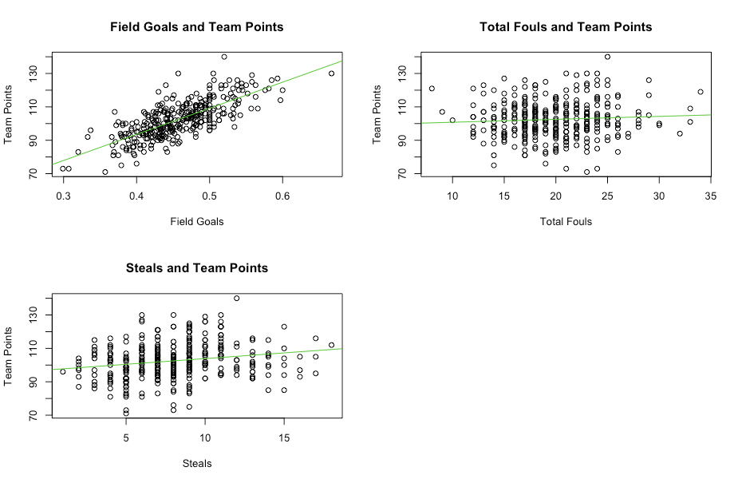
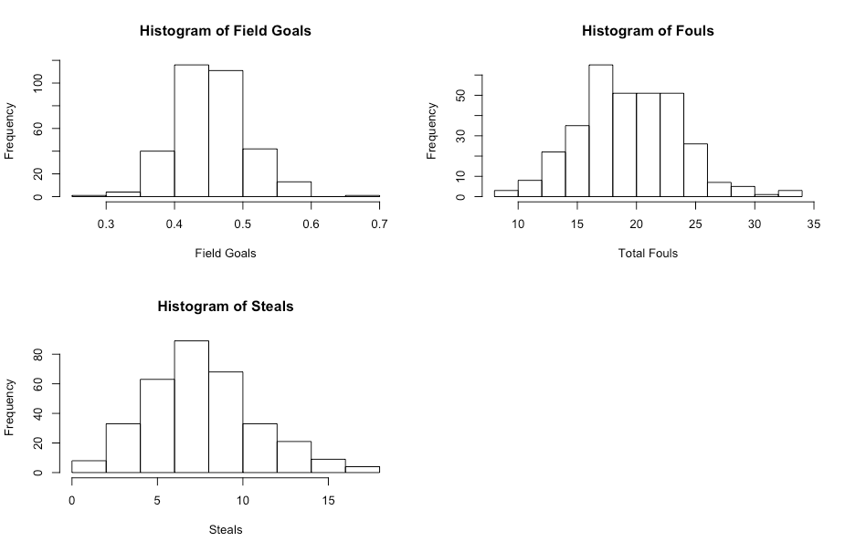
Part 3: Preliminary analysis: Boxplots, Scatterplots and Histograms
Notes:
Linear relationship between Team Points vs Assists, 3Pointshots, and Field Goals. Not correlated for Team Points vs Rebounds, Turnovers, Total Fouls, and Steals.
Histograms looks normal as they are all unimodal, except for Fouls is slightly right skewed.

Slide 8
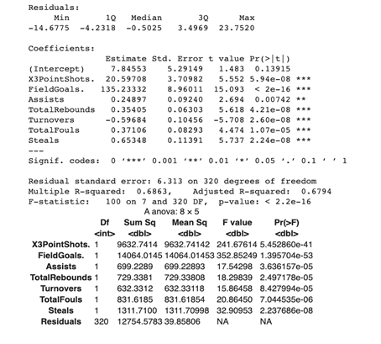
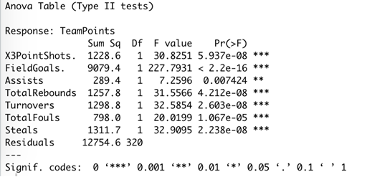
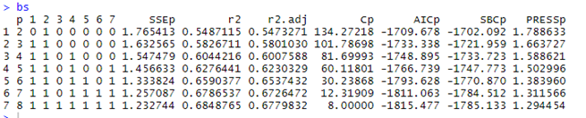
Part 4: Model building, diagnosis and validation
ANOVA (Type I)
ANOVA (Type II)
BestSub
FULL MODEL
TeamPoints ~ 7.85 + 20.60X3PointShots. + 135.23FieldGoals. + 0.25Assists + 0.35TotalRebounds - 0.60Turnovers + 0.37Total Fouls + 0.65Steals

Slide 9
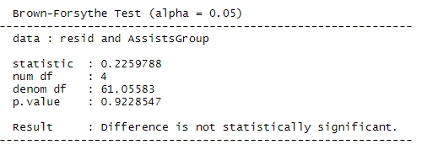
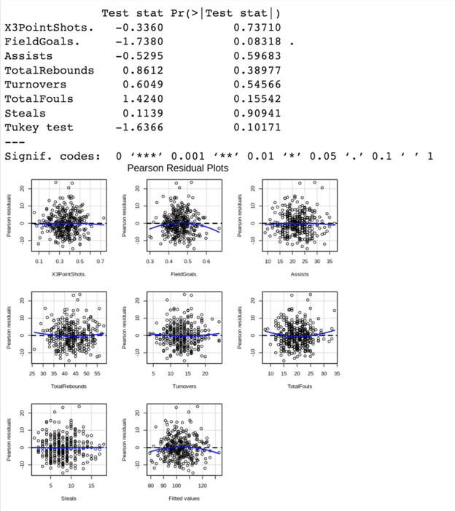
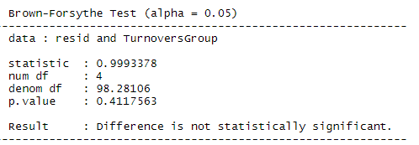
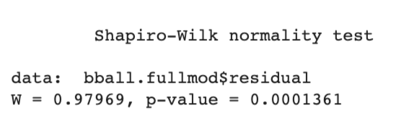
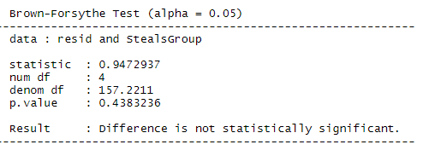
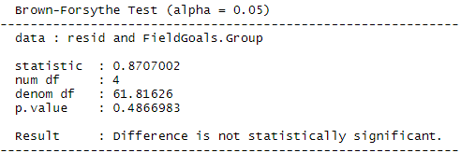
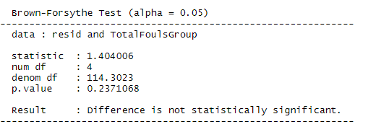
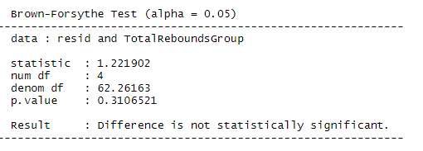
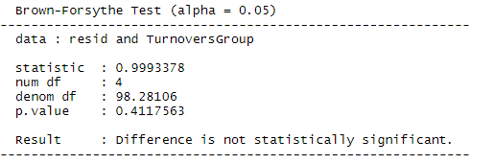
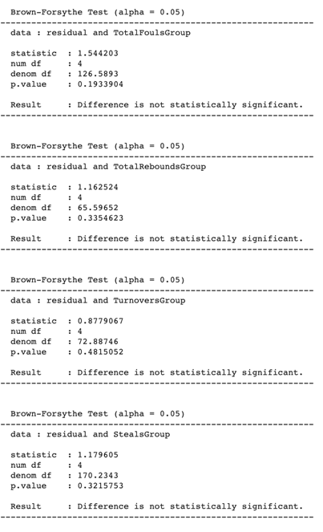
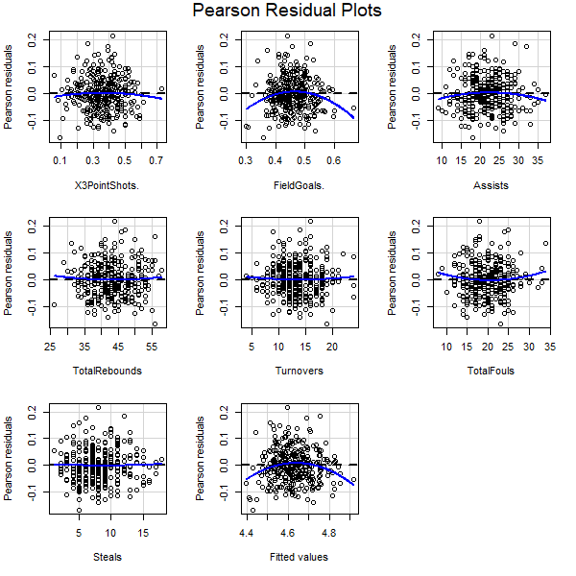
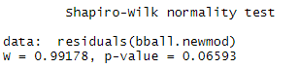
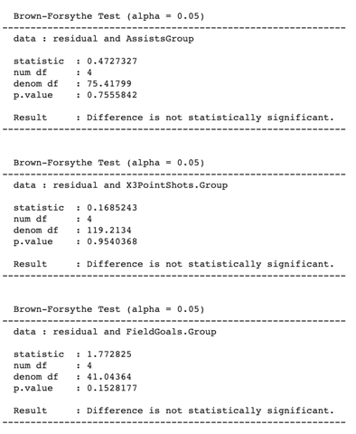
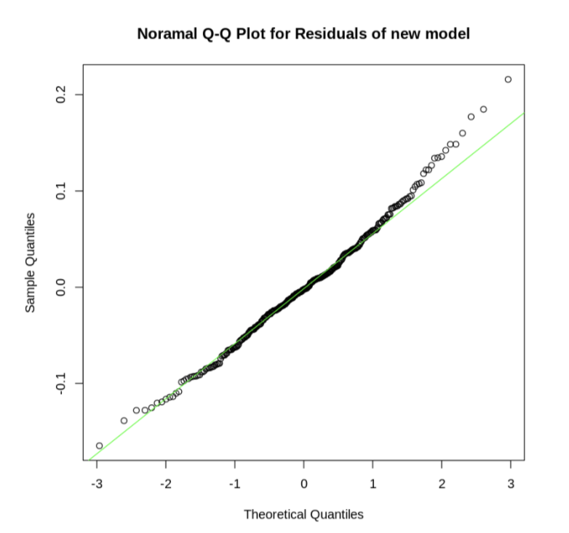
Part 4: Model building, diagnosis and validation
LINEARITY (Pearson Residuals Plot)
NORMALITY (Shapiro-Wilk Test)
HETEROSCEDASTICITY (Brown-Forsythe Test)
PRE-TRANSFORM
POST-TRANSFORM

Slide 10
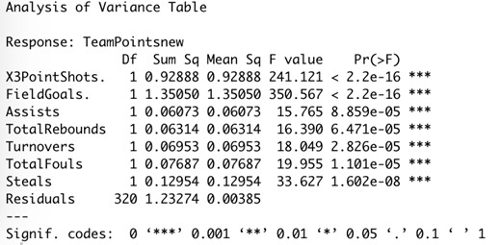
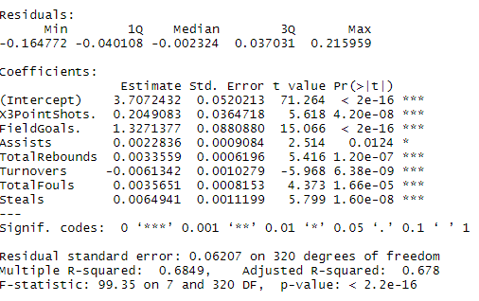
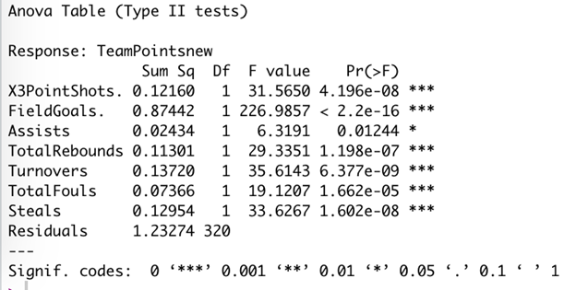
Part 4: Model building, diagnosis and validation
ANOVA (Type I)
Summary
ANOVA (Type II)
FINAL MODEL
TeamPointsnew ~ 3.71 + 0.205X3PointShots. + 1.327FieldGoals. + 0.002Assists + 0.003TotalRebounds - 0.006Turnovers + 0.004Total Fouls + 0.006Steals

Slide 11
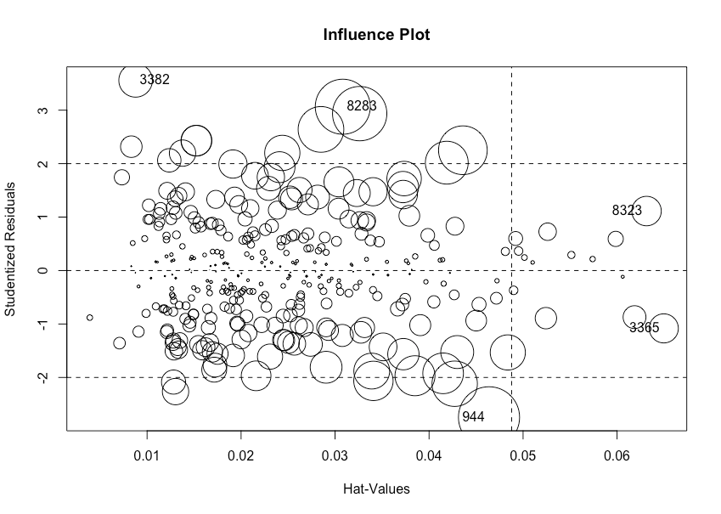
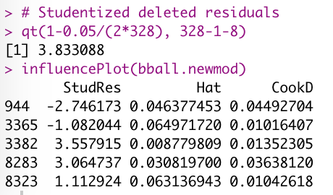
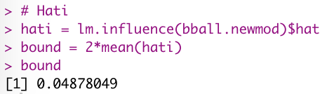
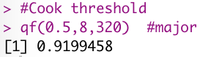
Part 4: Model building, diagnosis and validation

Slide 12
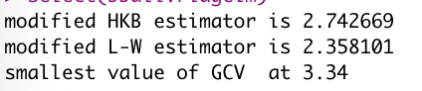
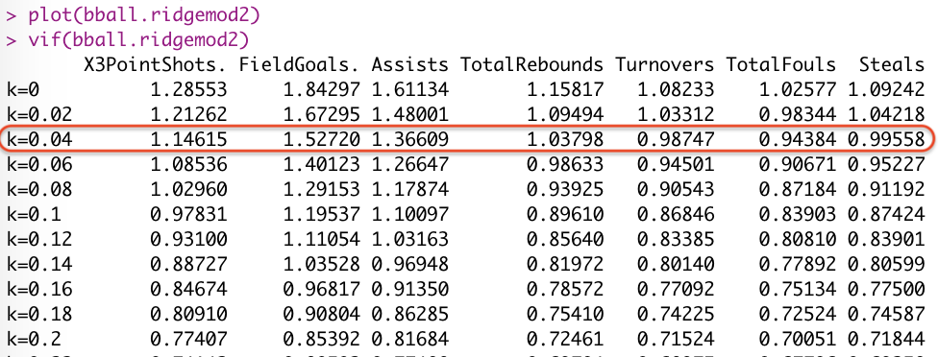
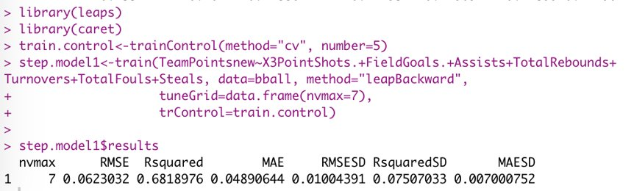
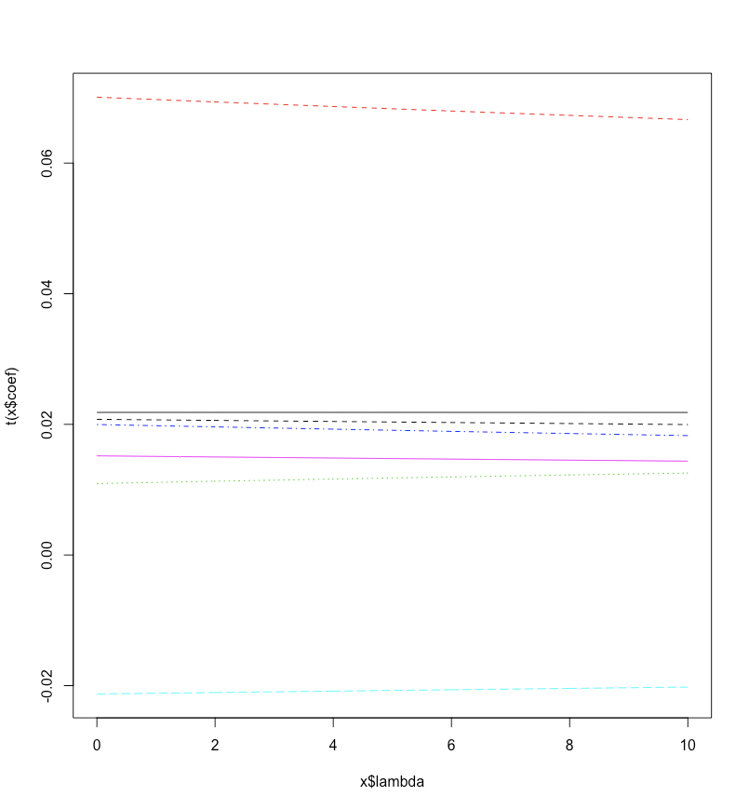
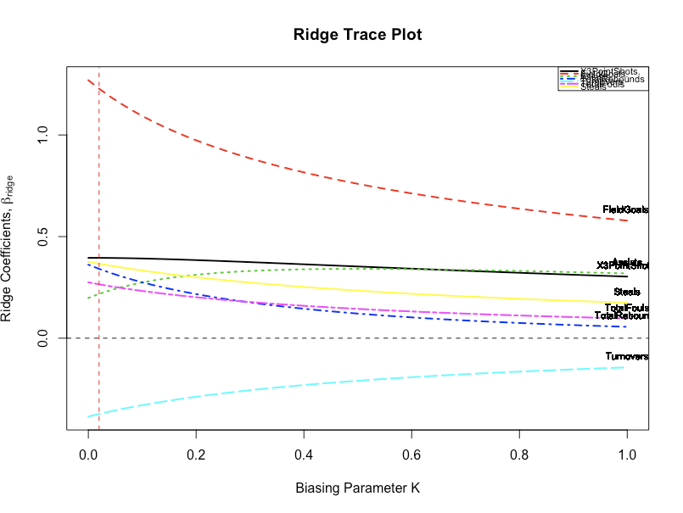
Part 4: Model building, diagnosis and validation
Ridge Trace Plot, with MASS and lmridge
Cross validation

Slide 13
Part 5: Final model report and application
Potential issue:
Shapiro-Wilk normality test indicated non—normality
Fix:
Ran box cox transformation
Got a new response variable
Final Model:
TeamPointsnew= 3.707+0.204X3PointShots+1.237FieldGoals+0.002Assists+0.003TotalRebounds−0.006Turnovers+0.003TotalFouls+0.006Steals
Notes:
Presenter Notes: To Estimate team points need to back-transfrom confidence intervals given by final model
Instructions: Relate to the potential issues you found in the preliminary analysis, specify how they are addressed and improved in the final model.

Slide 14
Factors that influence team points
Field Goals
Three Point Shots
Turnovers
Notes:
Which factors have the largest influence on the amount of points scored?
Field Goals, Three Point Shots, and Turnovers.
Is there significant relationship(s) between/among the selected factors?
NO.
How does a unit surge or decline in any of the factors impact amount of points scored?
Unit surges or declines have the most effect when applied to Field Goals, Three Point Shots, and Turnovers.
Note that ”FIELD GOALS” and “THREE POINT SHOTS” Represent the percentages of shots made.

Slide 15
Part 5: Comparison with literature
The proper selection of methodology is a crucial part of research study
Structural Equation Modeling | Regression Analysis
Used to assess the reliability and validity of the model measures. | - Evaluating constructs and relationships between constructs
Advantages -Explicit assessment of measurement error estimation of latent (unobserved) variables via observed variable -Model testing where a structure can be imposed and assessed as to fit of the data - Allows to develop complex path models with direct and indirect effects | Advantages - Simplicity of use and computation - Determine relative influence of one or more predictor variables to a criterion value - Ability to identify outliers or anomalies - Ease of interpretability of results
Disadvantages -Requires more than a single test of significance or single measure -Structural models—like all statistical models—are typically only approximations of reality, therefore omitting variables in the process of model building. -The parameter estimates and corresponding standard errors found by analysis are unbiased only under the assumption that the specified model is correct. | Disadvantages - Assumes a cause and effect relationship between the variables which might be misleading - Functional relationship established between any two/more variables on the basis of incomplete data may not hold as more and more data are taken into consideration - Involves very lengthy and complicated procedure of calculations and analysis

Slide 16
Conclusion
•Future scope
Applications
Improvements
•Acknowledgments

Slide 17
References
Akers, M. D., Wolff, S., & Buttross, T. E. (1992). An empirical examination of the factors affecting the success of NCAA Division I College Basketball teams. Journal of Business and Economic Studies.
Csataljay, G., O’Donoghue, P., Hughes, M., & Dancs, H. (2009). Performance indicators that distinguish winning and losing teams in basketball. International Journal of Performance Analysis in Sport, 9(1), 60-66.
Hofler, R. A., & Payne, J. E. (1997). Measuring efficiency in the national basketball association. Economics letters, 55(2), 293-299.
Hojka, V., Stastny, P., Rehak, T., Gołas, A., Mostowik, A., Zawart, M., & Musálek, M. (2016). A systematic review of the main factors that determine agility in sport using structural equation modeling. Journal of human kinetics, 52, 115–123. https://doi.org/10.1515/hukin-2015-0199​
Kelepouris, I. (2018). NBA Team Game Stats from 2014 to 2018. Retrieved from https://www.kaggle.com/ionaskel/nba-games-stats-from-2014-to-2018
Oliver, D. (2005). What wins basketball games, a review of „Basketball on paper: Rules and tools for performance analysis”. Polomac Books, 26-85.
Mikołajec, K., Maszczyk, A., & Zając, T. (2013). Game Indicators Determining Sports Performance in the NBA. Journal of human kinetics, 37, 145–151.
Sampaio, J., & Janeira, M. (2003). Statistical analyses of basketball team performance: understanding teams’ wins and losses according to a different index of ball possessions. International Journal of Performance Analysis in Sport, 3(1), 40-49.
Notes:
Use this slide to house references

